Slide 1
Getting started with Python
By Anirudh K M
Analyst
Mobius Knowledge Services

Slide 2
Python objects
The foremost thing to remember in Python is that everything is treated as object.
Every object has a type associated with it.
Object’s can be classified as follows:
Scalar – which cannot be subdivided.(int, float etc).
Non-scalar – which can have internal data objects to access. (Lists, Tuples etc).

Slide 3
Scalar Objects
int – used to represent integer. e.g. 5, 12, -8
float – used to represent floating point numbers. e.g. 12.44, -922.33
bool – used to represent True or False.
With built in Python function type, we can know the type of object.

Slide 4
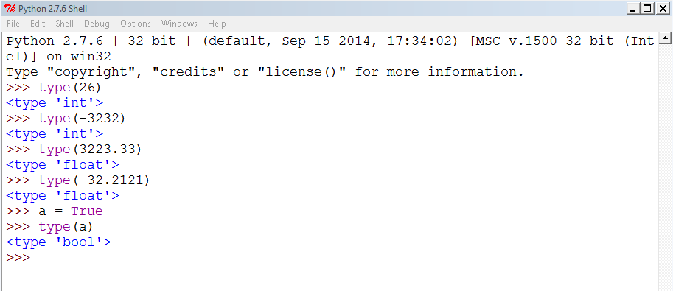
Illustration

Slide 5
Expression
Expressions are obtained by combining objects and operators.
Example of one of the most simple expression:
<object> <operator> <object>.
It is important to note that expressions too always returns an object with some type.

Slide 6
Operations on ints and floats
a + b → sum.
a – b →difference.
a * b → multiplication.
a / b → division, returns the quotient.
a % b → returns the reminder
a**b → returns the value of ‘a’ raised to power ‘b’.
Note: If both objects are of same type returns value of the same type, else return object flavors the higher precedence.

Slide 7
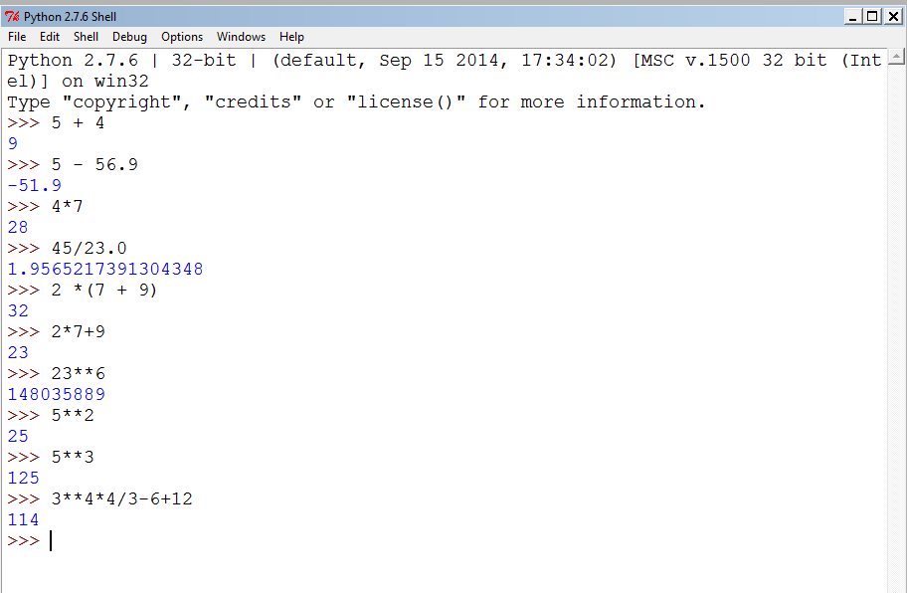
Illustration

Slide 8
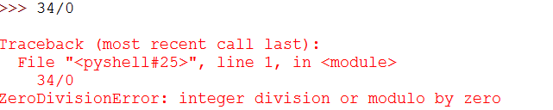
Illustration
Here we see the compiler throws an error to us when we divide by zero. We will see how to handle these in coming lectures.
Notes:
<number>

Slide 9
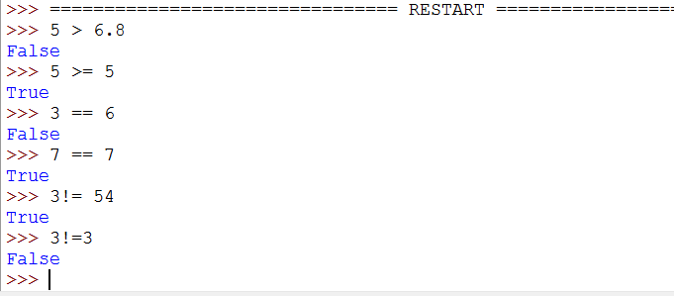
Illustration – Comparison operators

Slide 10
Boolean Operators
a and b → True, if both ‘a’ and ‘b’ are True.
a or b → True, neither if one of ‘a’, ‘b’ is True.
not a → True, if ‘a’ is False.
Note: ‘a’ and ‘b’ here are of bool type.
Also and holds higher precedence to or.

Slide 11
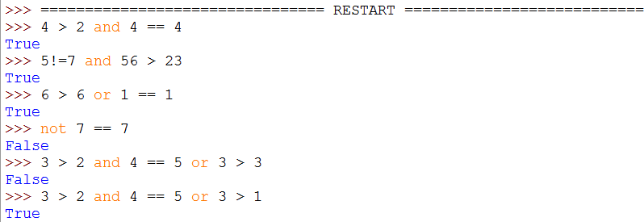
Illustration

Slide 12
Type Conversions
As we saw earlier, if we operate with two different data type objects we obtain the result with the object of higher precedence.
But if we want to obtain the results in the lower precedence, then we need to go for type conversions, which is illustrated as follows.

Slide 13
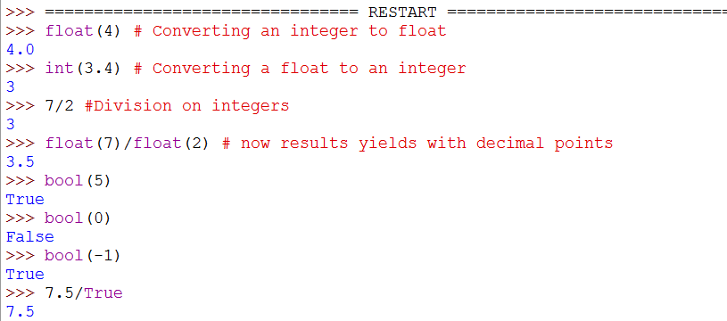
Illustration

Slide 14
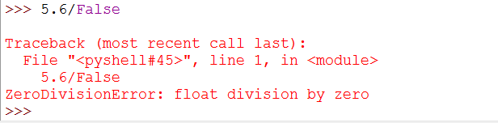
Illustration
Here we see that division by False, yields an error. This is because False is treated to an equivalent of zero. We will see about this bool statements in details in following topics.

Slide 15
Variables
We all know that variables provide a great way to reuse values.
The values are mapped into the variable in some part of memory.
I insist you to look upon the PEP8(Python Enhancement Proposal-8) for naming variables here http://goo.gl/2FO8K5.
We will start developing scripts synchronizing with these standards as we dive deep into Python.

Slide 16
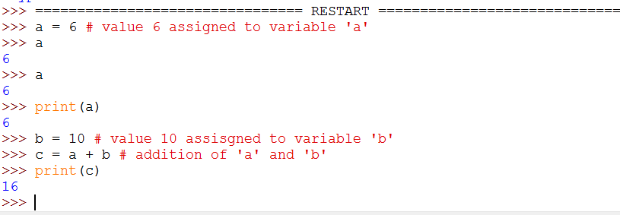
Illustration

Slide 17
Comparison Operations on Ints and Floats
a > b → returns True, when ‘a’ is always greater than ‘b’.
a >= b → returns True, when ‘a’ is greater or equal to ‘b’.
a == b → returns True if ‘a’ equals ‘b’.
a != b → returns True when ‘a’ is not equal to ‘b’

